Slide 1
Generations of Computer
From Vacuum Tubes to Artificial Intelligence

Slide 2
Introduction
Computers evolved in five generations.
Each generation brought new technology.
Improved speed, efficiency, storage, and reliability.

Slide 3

First Generation (1940–1956)
Technology: Vacuum tubes
Size: Very large, required AC & cooling
Examples: ENIAC, UNIVAC
Disadvantages: Expensive, generated heat, less reliable

Slide 4
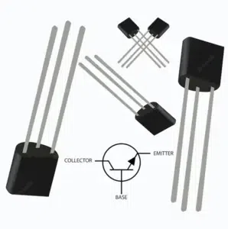
Second Generation (1956–1963)
Technology: Transistors
Smaller, faster, more reliable than vacuum tubes
Used assembly language
Examples: IBM 1401, IBM 7090

Slide 5
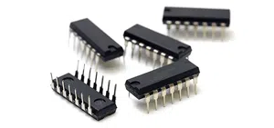
Third Generation (1964–1971)
Technology: Integrated Circuits (ICs)
More compact, powerful, cost-efficient
Introduced high-level programming languages
Examples: IBM 360 Series

Slide 6
Fourth Generation (1971–1980s)
Technology: Microprocessors
Computers became smaller & affordable
Introduction of personal computers (PCs)
Examples: Apple II, IBM PC

Slide 7
Fifth Generation (1980s–Present)
Technology: Artificial Intelligence & parallel processing
Features: Machine learning, voice recognition, robotics
Modern devices: Laptops, Smartphones, Supercomputers

Slide 8
Thank you!!!

